Slide 1

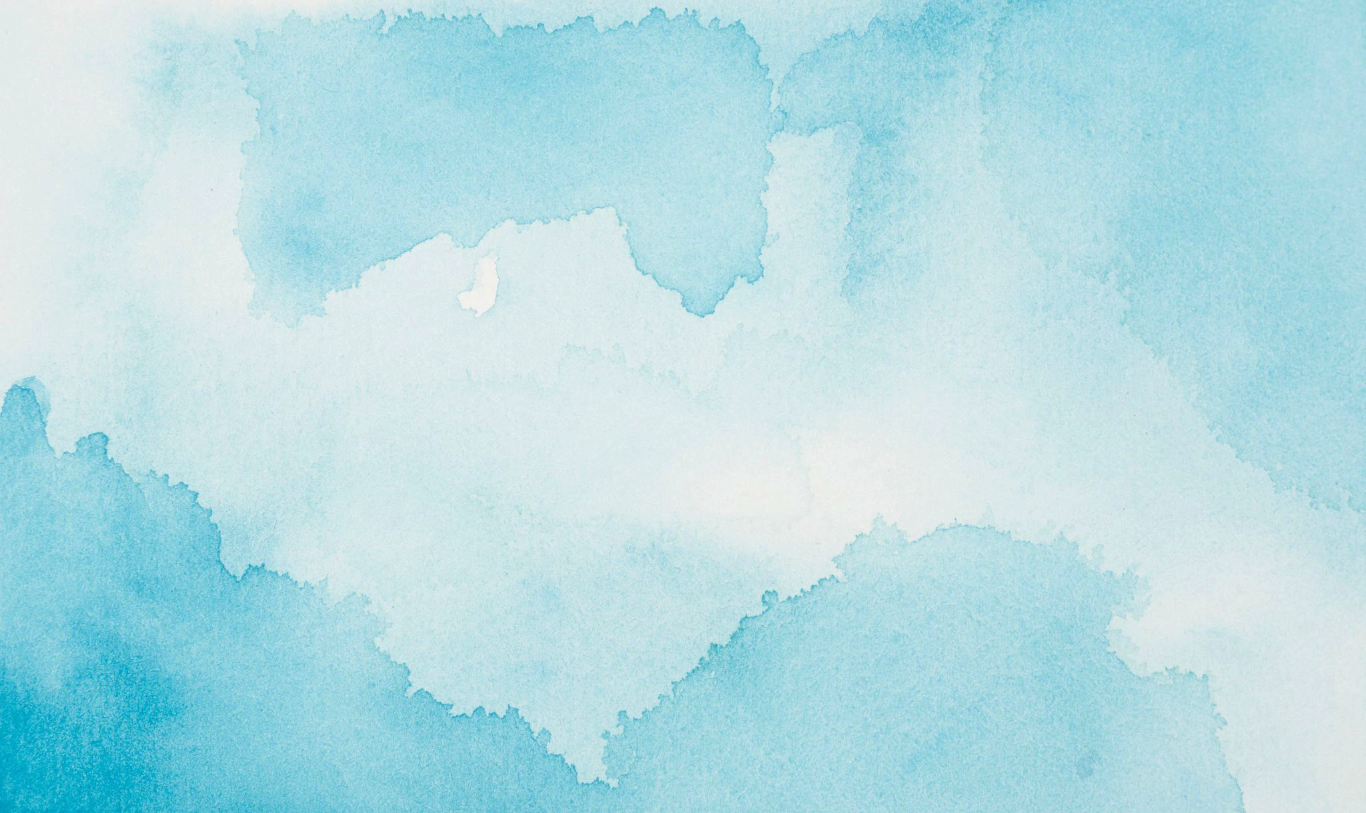




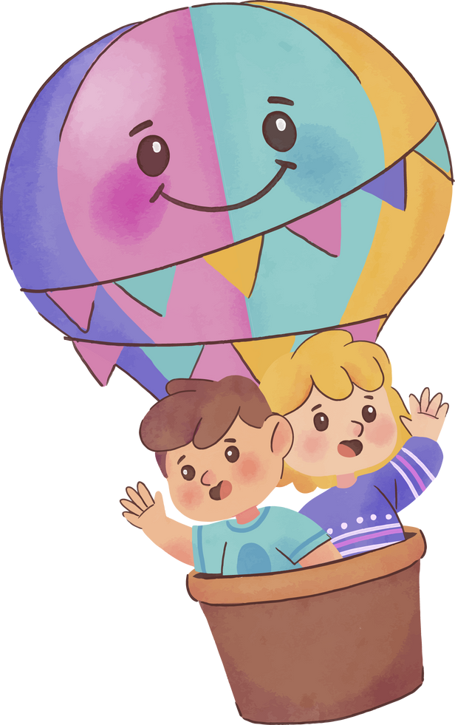



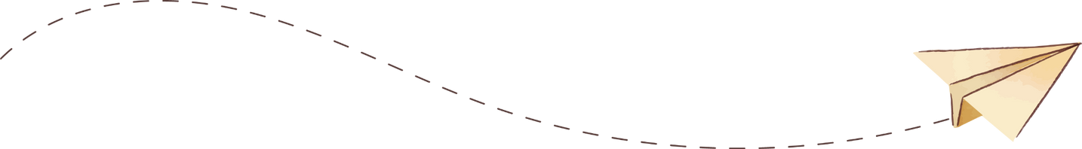


Creative arts
for stress reduction Exploring Art Therapy

Slide 2
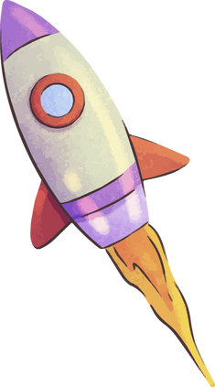
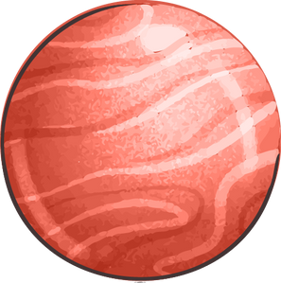
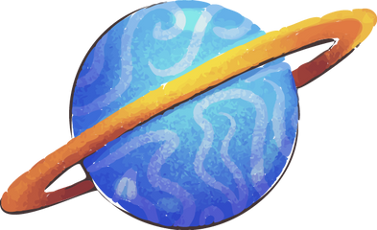
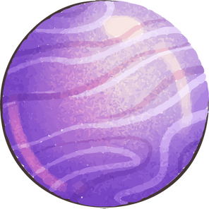

Workshop objectives
Benefits of creative arts for stress management
Create art for emotional exploration and relaxation.
02
01
Learn how to integrate art into daily routines
03

Slide 3
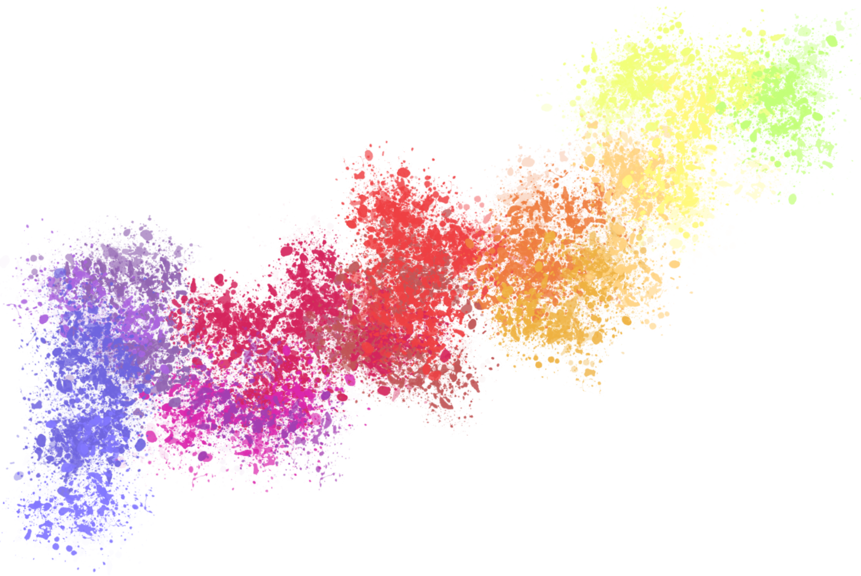

If you were a color, what would it be?
What personal traits or emotions do you think this color expresses?
Notes:
Encourage participants to reflect on a color that represents them as individuals, rather than a temporary mood. Provide a brief interpretation of the chosen color to prompt further self-reflection.

Slide 4
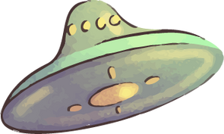
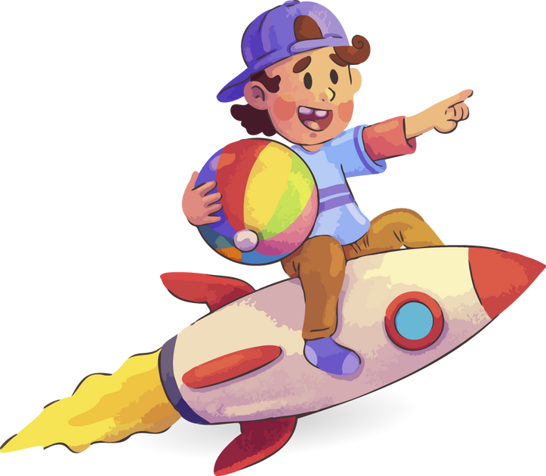
Why Art?
Art offers us a universal language to express ourselves.
No talent is needed.
Just a willingness to explore.
Notes:
Share something personal about your relationship with art to make the session feel more open and engaging.

Slide 5



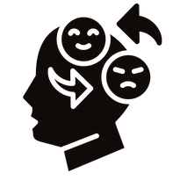

The Healing Power of Art
Mindfulness
Building confidence
Focus on the present, leaving daily worries behind.
Creating art without the pressure for perfection can boost self-confidence.
Emotional release
Connection
Express deeply held feelings.
Connect with ourselves and others.
Notes:
Use a conversational tone and ask participants if they’ve ever experienced these benefits, even by accident (e.g., through drawing or coloring). Invite personal reflections or examples.

Slide 6
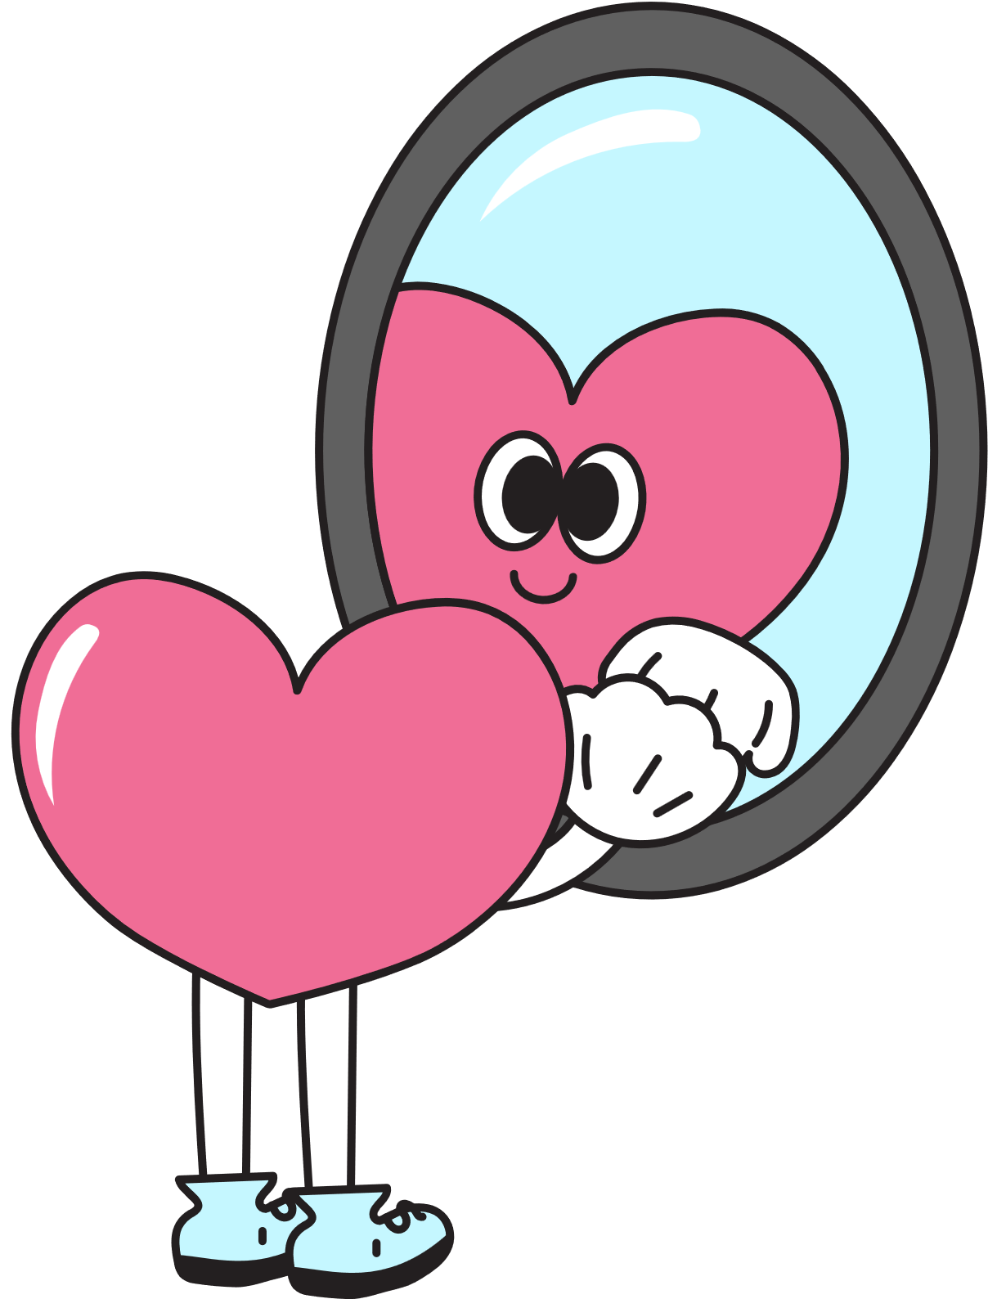
What is an emotional self-portrait?
Is a form of personal expression
Not about realism
No judgments
Benefits
This portrait doesn’t aim to look like you physically. It reflects inner experiences, emotions, and states of mind.
It’s a safe space for emotional release and self-reflection with no right or wrong way to express yourself.
Bring clarity to how we’re feeling and can reveal emotions that might be overlooked in everyday life.
Notes:
Explain that the activity isn’t about creating a “perfect” image, but rather exploring feelings freely. Encourage participants to create their portraits without judgment.

Slide 7
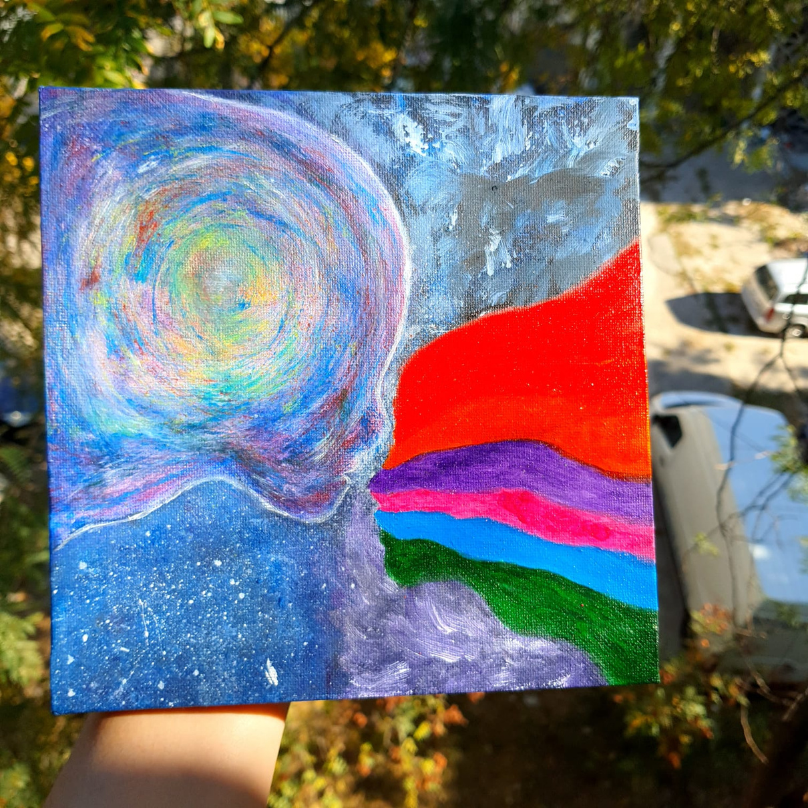
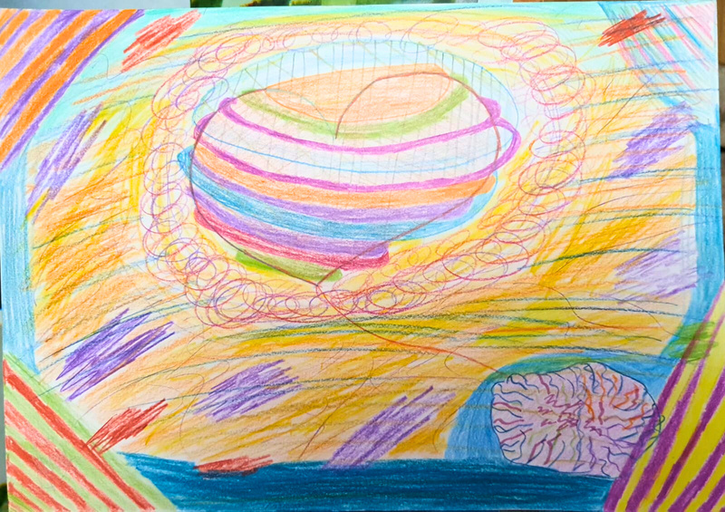
How am I feeling right now?
Think about what feelings are present and how you might represent them.
Notes:
Lead a short breathing exercise, asking participants to visualize or think about their emotions before starting. This helps transition into a creative, introspective mindset.

Slide 8
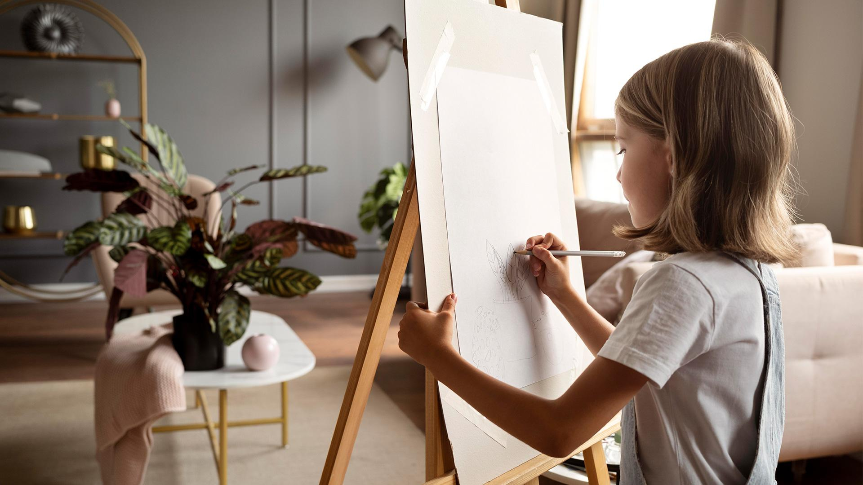
Creating Your Emotional Self-Portrait
Notes:
- Use colors, shapes, and patterns that resonate with your current emotions. Focus on expressing how you feel rather than what you look like.
- Key Tips: Use lines, colors, or symbols that feel right in the moment. Don’t worry about creating a recognizable image—let your emotions guide your hands.
- Reassure participants that there’s no wrong way to create their self-portrait. Encourage them to be free and intuitive, letting their emotions flow onto the page.

Slide 9
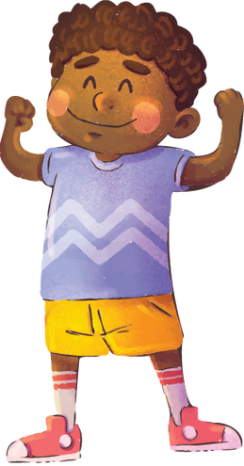

What did you notice about your emotions during this process?
How did it feel to express them through art?
Notes:
Invite participants to share their thoughts or feelings. Ask open-ended questions to prompt reflection on what the process revealed about their emotions or state of mind.

Slide 10
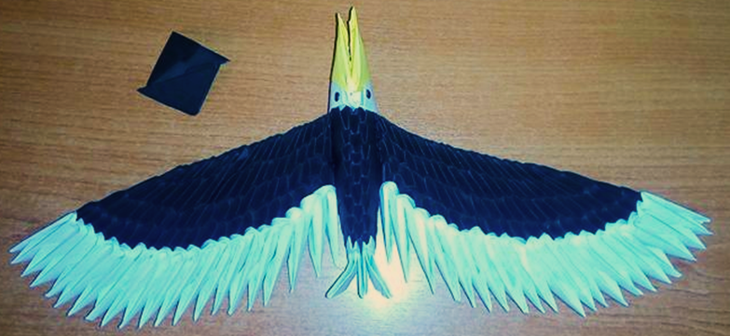
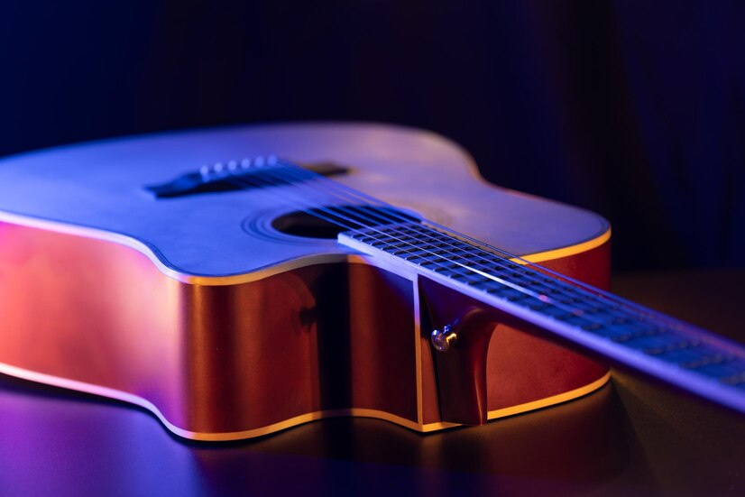
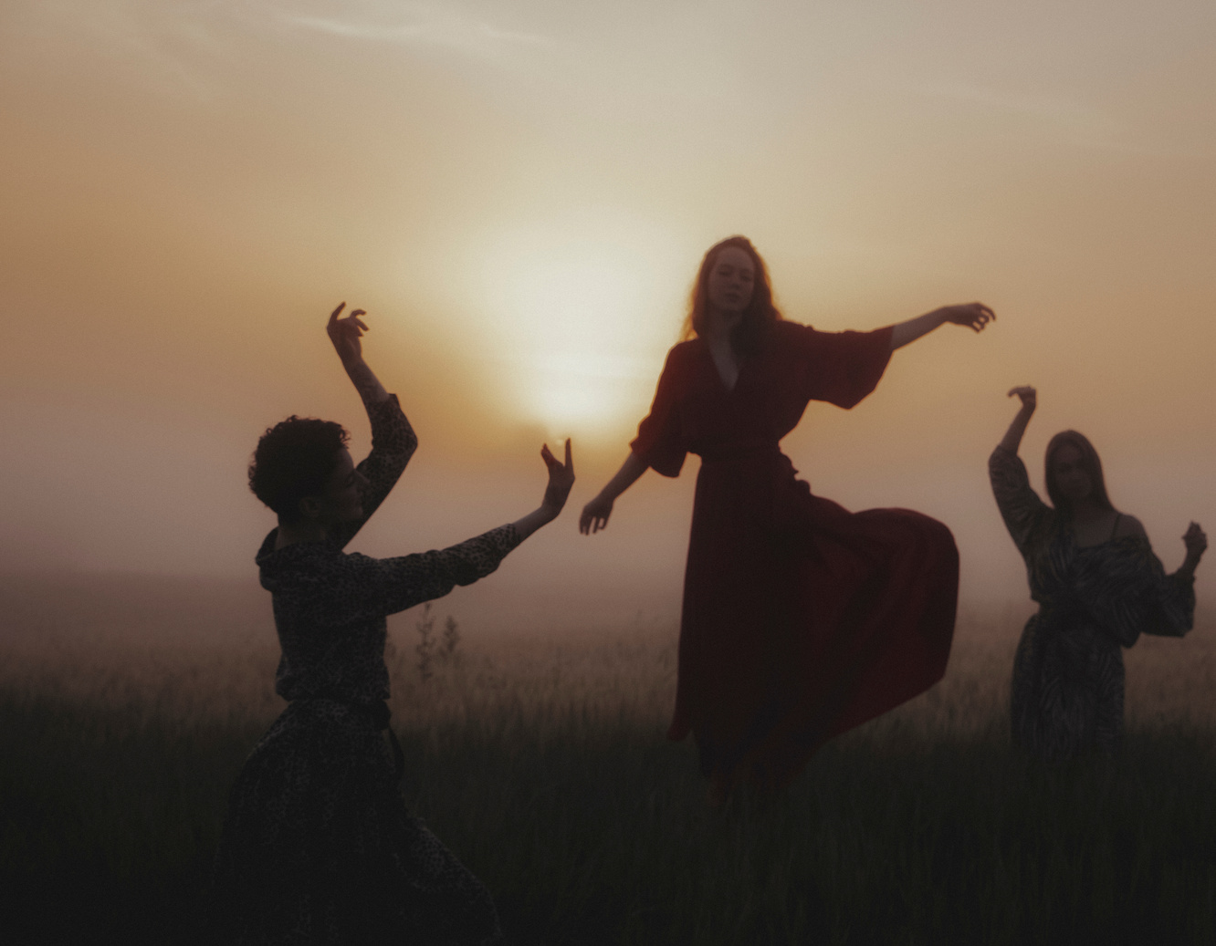
Using art in daily life for relaxation
Origami
Music
Dance
Notes:
Emphasize that art is versatile. Participants don’t need to focus solely on drawing or painting. Encourage them to explore multiple forms to find what resonates with them.

Slide 11
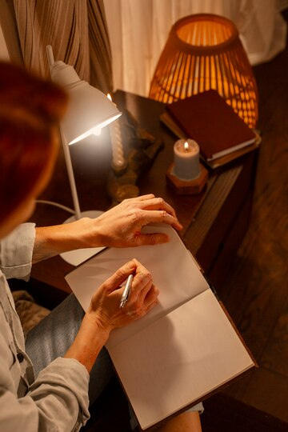
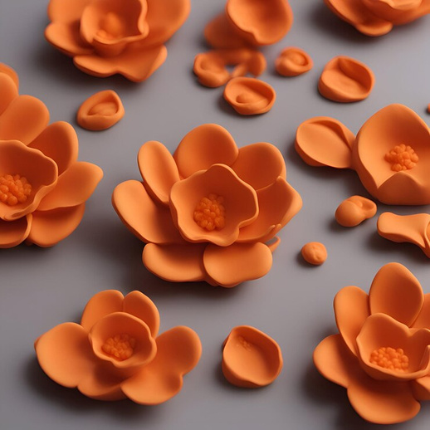
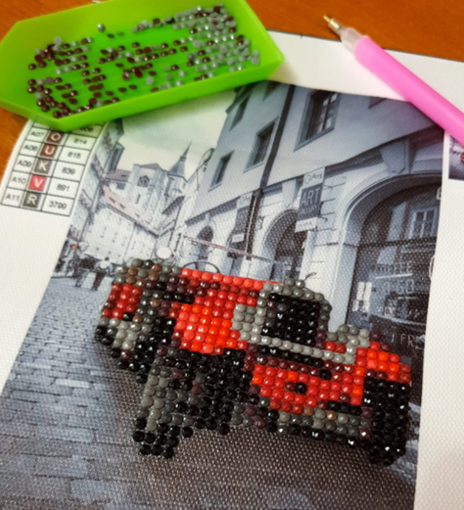
Using art in daily life for relaxation
Sculpture/Clay work
Handmade /puzzle
Writing/poetry

Slide 12
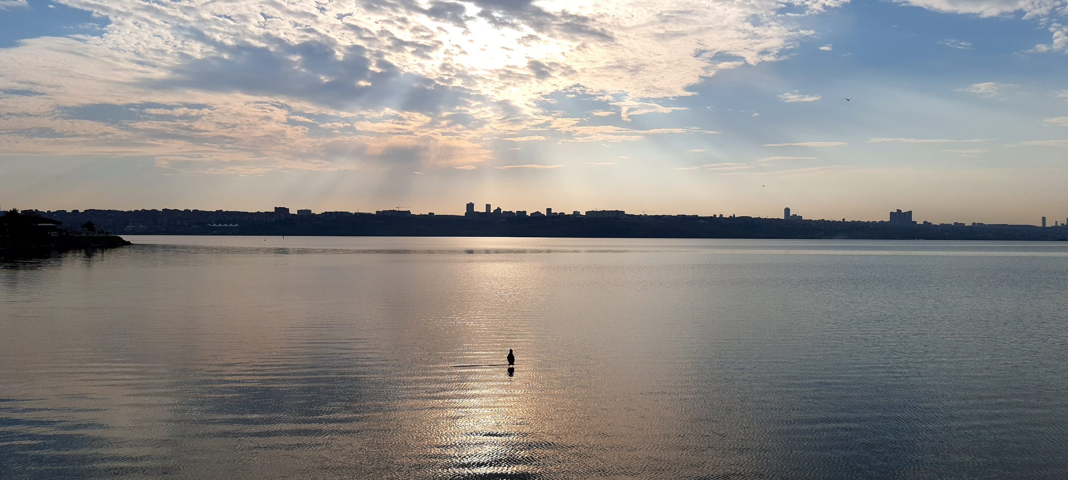
Thank you!

